Slide 1





Human mobility analysis and simulation with Python
Luca Pappalardo
@lucpappalard
Roberto Pellungrini
@pellungrobe
Gianni Barlacchi
@GianniBarlacchi
Applied Machine Learning Days, Lausanne. Switzerland
Notes:
Luca

Slide 2

Predict flu-like symptoms
Individual mobility behaviours is used to predict the future presence of flu-like symptoms (e.g. cold, fever and cough).
Past mobility behaviours
will you be sick?
April 6th
April 8th
April 4th
April 6th
Are you getting sick? Predicting influenza-like symptoms using human mobility behaviors (Barlacchi et al.)

Slide 3
Monitoring of poverty
In resource-constrained environments censuses and household surveys are rare and difficult to obtain.
Individual past mobile phone behaviour, including mobility, can be used to infer his or her socioeconomic status.
The predicted attributes of millions of individuals are used to reconstruct the distribution of wealth of an entire nation
Predicting poverty and wealth from mobile phone metadata (Blumenstock et al.)

Slide 4
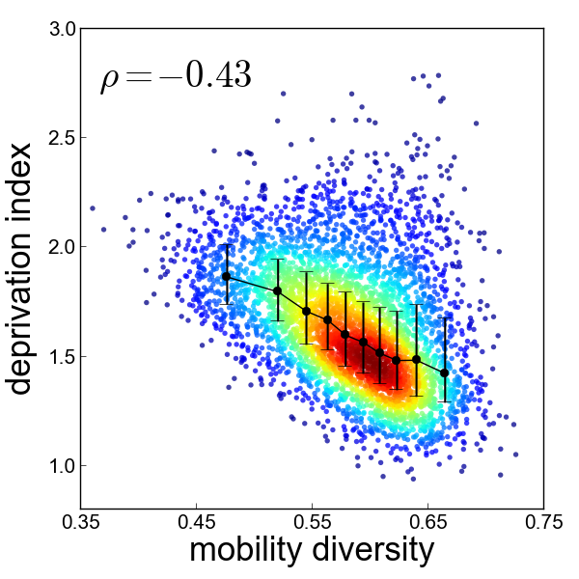
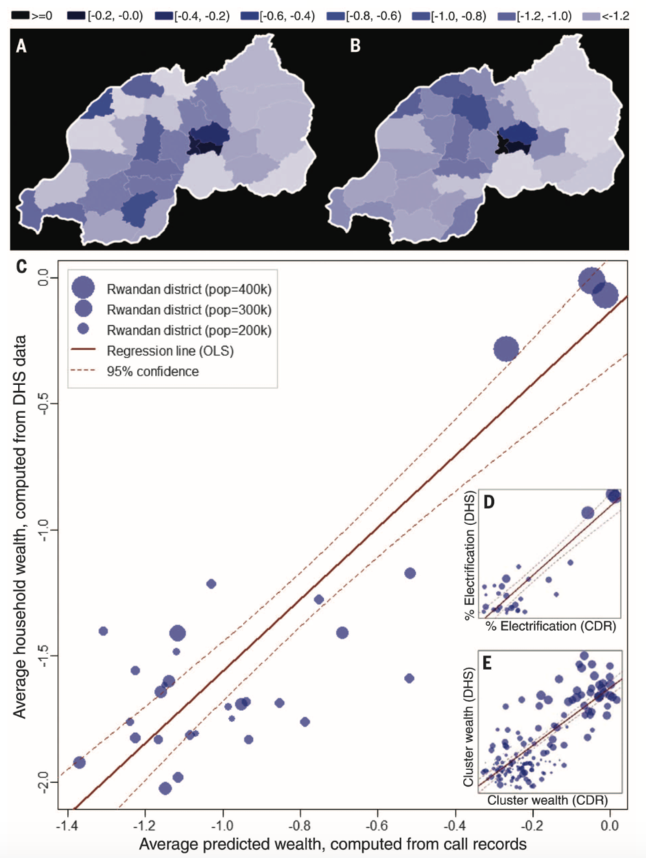
Mobility and government data
An analytical framework to nowcast well-being with mobile phone data (Pappalardo et al.)
Notes:
Functionality = business, night life

Slide 5
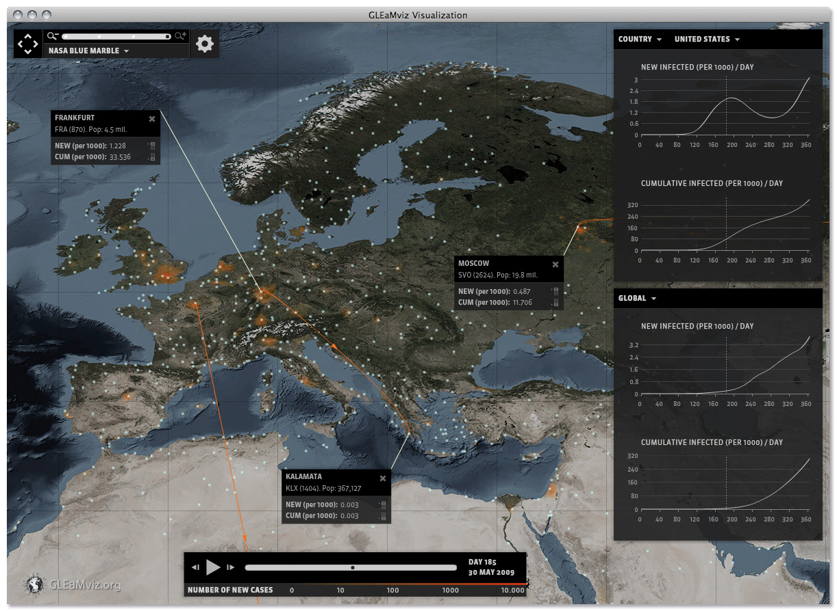

Forecasting flu
The GLEaMViz computational tool, a publicly software to explore realistic epidemic spreading scenarios at the global scale. (Van den Broek W. et al.)
Notes:
Functionality = business, night life

Slide 6
Current developments
predictive models
visualization module
map matching
anonymization techniques
Notes:
Health
Infectious diseases spread because people move. In the past epidemics like the black plague were diffusing slowly from one town the nearest one, today new flu strains like H1N1 spread faster across the continents travelling on the air transport network
Transportation affects our health in other ways too: in the US the typical commute lasts more than 30 minutes: overall we spend 1 hour travelling
the stress associated with traffic jams has an impact on our wellbeing, while the pollutants released by combustion engines pose a threat to our health
Environment
These pollutants do not harm just humans, but other species and the environment as well. Transportation is the second source of greenhouse gas emissions to the atmosphere and is one of the main human activities contributing to global warming and climate change.
Economy
In the EU transportation the second largest expenditure category after housing (15-25%). More efficient forms of transportation and better urban planning could help us save money and reduce the damage we do to the environment.

Slide 7
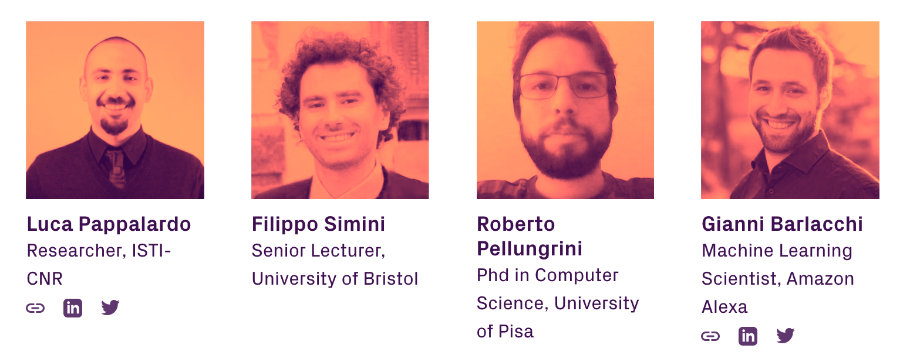
https://github.com/scikit-mobility/

Slide 8
How to contribute?
contact us
open an issue
make a pull request

Slide 9
Thank you!
Luca Pappalardo
@lucpappalard
Roberto Pellungrini
@pellungrobe
Gianni Barlacchi
@GianniBarlacchi
Applied Machine Learning Days, Lausanne. Switzerland
Notes:
Luca

